Slide 1
Servlets

Slide 2
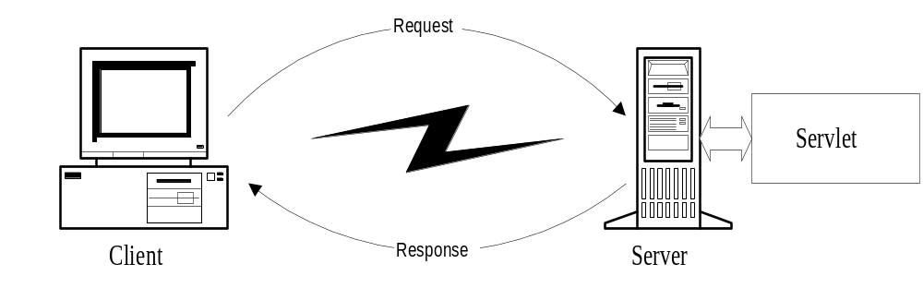
What is java servlet ?
A servlet is a small Java program that runs within a Web server. Servlets receive and respond to requests from Web clients, usually across HTTP, the HyperText Transfer Protocol. Servlet is an opposite of applet as a server-side applet. Applet is an application running on client while servlet is running on server.

Slide 3
What is Java Servlets?
Servlet
  module run inside request/response-oriented server
Browser
HTML form
Java-enabled
Web Server
Servlet
Database
  Servlets are to Servers what Applets are to Browsers
Servlet
=
Applet
Server
Browser
  Substitute for CGI scripts
    easier to write and fast to run
  Not part of the core Java Framework
Notes:
1. 서블릿의 개념
- 서버측에서 클라이언트측의 요구를 받아 그에 대한 처리를 한 후 결과를 되돌리는 모듈이다.
2. 애플릿/서블릿
애플릿은 서버측에서 작성되었지만, 코드가 클라이언트로 다운로드되어 실행되는 반면, 서블릿은 서버 측에서 직접 실행되어 그 결과만 반환된다는 점에서 오히려 CGI와 비슷하다. 하지만,CGI보다는 요구와 결과를 처리하는 방법이 더 쉽다.
3. JDK의 기본 패키지가 아니다. 서블릿을 작성하려면, JDK외에 JSDK(98년 중반 현재 2.0까지 발표)를 다운로드받아야 한다.
4. 서블릿을 동작시키려면, 서블릿 실행을 처리할 수 있는 웹 서버 또한 존재해야 한다.

Slide 4
Why Use Servlets ?
One of the reasons that Java became popular is Applets.
  but there are problems with Applets
    Browser compatibility
    Download bandwidth
Server-side Java
  the code is executed on the server side not the client side
  a dynamically loaded module that services requests from a Web server

Slide 5
Servlets (contd.)
  vs. Common Gateway Interface (CGI)
    create new process for each request
      most platform independent CGI language - Perl
        start a new instance of interpreter for every request
    CGI runs in a completely separate process from the Web server
  vs. Server-Side JavaScript
    only available on certain web servers
  vs. Active Server Pages (ASP)
    only available on certain web servers

Slide 6
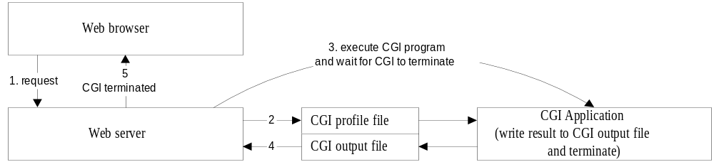
CGI Communication (traditional approach)
1. Web browser requset a response from CGI program.
2. Web server create CGI profile file that was contain information about CGI variable, server and CGI output file.
3. Web server starts CGI application and wait for its termination.
4. CGI program runs and writes the result to CGI output file and then terminates.
5. Web server reads from CGI output file and send back to Web browser.

Slide 7
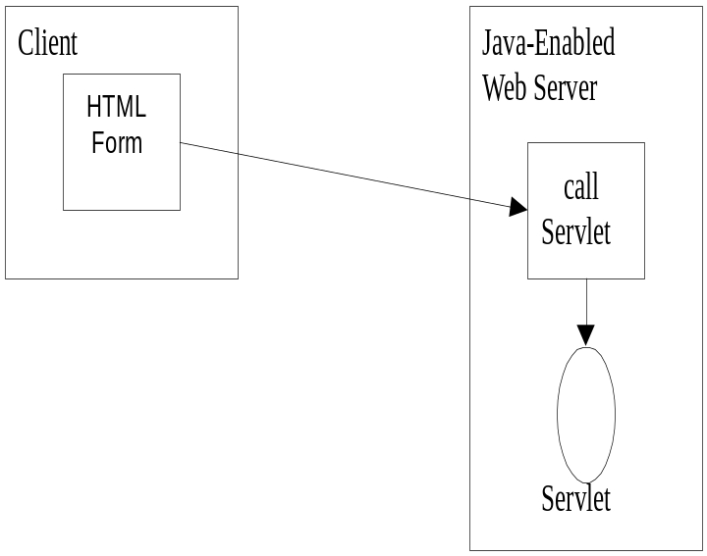
Servlet Communication
Web browser request servlet by specified URL as http://www.host.com/serlet/servletName
Web server call service() method in ServletLoader class which will dynamically load a specified servlet name from a special directory call servlet.

Slide 8
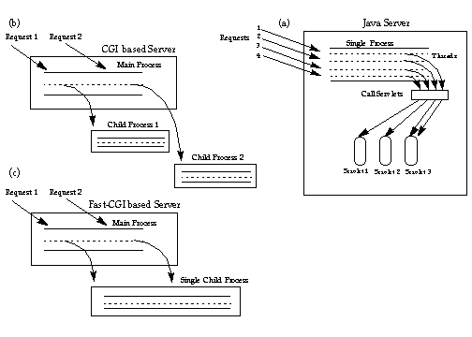
Servlet vs CGI
Servlet run as light weight thread in process.
CGI run as heavy weight process.

Slide 9
Servlets vs. CGI
Perl 1
A Servlet does not run in a separate process.
A Servlet stays in memory between requests.
A CGI program needs to be loaded and started for each CGI request.
There is only a single instance of a servlet which answers all requests concurrently.
Browser 1
Web
Server
Perl 2
Browser 2
Browser N
Perl N
Servlet
Browser 1
Web
Server
Browser 2
Browser N

Slide 10
Advantage of servlet over CGI
PlatForm Independence
Servlets can run on any platform. PERL also can be moved from platform to platform while CGI such as C are not portable.
Performance
Servlets only needs be loaded once, while CGI programs needs to be load for every request so that servlet should performs faster than CGI
Security
While CGI can do many insecure things, java provided security in language level.

Slide 11
Benefits of Java Servlets
Performance
  The performance of servlets is superior to CGI because there is no process creation for each client request.
  Each request is handled by the servlet container process.
  After a servlet has completed processing a request, it stays resident in memory, waiting for another request.
Portability
  Like other Java technologies, servlet applications are portable.
Rapid development cycle
  As a Java technology, servlets have access to the rich Java library that will help speed up the development process.
Robustness
  Servlets are managed by the Java Virtual Machine.
  Don't need to worry about memory leak or garbage collection, which helps you write robust applications.
Widespread acceptance
  Java is a widely accepted technology.

Slide 12
Definitions
A servlet is a Java class that can be loaded dynamically into and run by a special web server.
This servlet-aware web server, is known as servlet container.
Servlets interact with clients via a request-response model based on HTTP.
Therefore, a servlet container must support HTTP as the protocol for client requests and server responses.
A servlet container also can support similar protocols such as HTTPS (HTTP over SSL) for secure transactions.

Slide 13
Servlet Container Architecture
HTTP Request
Servlet
Container
Servlet
Browser
HTTP
Server
HTTP Response
Static
Content

Slide 14
How Servlets Work
is servlet
loaded?
Receive
Request
No
Yes
is servlet
current?
No
Load Servlet
Yes
Send
Response
Process Request

Slide 15
Servlet APIs
Every servlet must implement javax.servlet.Servlet interface
Most servlets implement the interface by extending one of these classes
  javax.servlet.GenericServlet
  javax.servlet.http.HttpServlet

Slide 16
Generic Servlet & HTTP Servlet
Client
GenericServlet
request
Server
service ( )
response
Browser
HTTPServlet
doGet
request
( )
HTTP Server
service ( )
response
doPost
( )

Slide 17
Interface javax.servlet.Servlet
The Servlet interface defines methods
  to initialize a servlet
  to receive and respond to client requests
  to destroy a servlet and its resources
  to get any startup information
  to return basic information about itself, such as its author, version and copyright.
Developers need to directly implement this interface only if their servlets cannot (or choose not to) inherit from GenericServlet or HttpServlet.
Life
Cycle
Methods

Slide 18
GenericServlet - Methods
void init(ServletConfig config)
  Initializes the servlet.
void service(ServletRequest req, ServletResponse res)
  Carries out a single request from the client.
void destroy()
  Cleans up whatever resources are being held (e.g., memory, file handles, threads) and makes sure that any persistent state is synchronized with the servlet's current in-memory state.
ServletConfig getServletConfig()
  Returns a servlet config object, which contains any initialization parameters and startup configuration for this servlet.
String getServletInfo()
  Returns a string containing information about the servlet, such as its author, version, and copyright.

Slide 19
Servlet Life Cycle
Initialization
init()
Service
service()
doGet()
doPost()
doDelete()
doHead()
doTrace()
doOptions()
Concurrent
Threads
of Execution
Destruction
destroy()
Notes:
In the Request Processing phase a JSP page is handled exactly like a regular servlet. Servlets follow a three-phase life cycle: initialization, service, and destruction, with initialization and destruction typically performed once, and service performed many times.
Initialization is the first phase of the Servlet life cycle and represents the creation and initialization of resources the Servlet may need to service requests. For example open a db connection, read ancillary files, get runtime parameters. All Servlets must implement the javax.servlet.Servlet interface. This interface defines the init() method to match the initialization phase of a Servlet life cycle. When a container loads a Servlet, it invokes the init() method before servicing any requests.
The service phase of the Servlet life cycle represents all interactions with requests until the Servlet is destroyed. The Servlet interface matches the service phase of the Servlet life cycle to the service() method. The service() method of a Servlet is invoked once per each request and is responsible for generating the response to that request. By default a Servlet is multi-threaded, meaning that typically only one instance of a Servlet is loaded by a JSP container at any given time. Initialization is done once, and each request after that is handled concurrently by threads executing the Servlet’s service() method. This implies that a developer needs to be careful in synchronizing shared resources.
The destruction phase of the Servlet life cycle represents when a Servlet is being removed from use by a container. The Servlet interface defines the destroy() method to correspond to the destruction life cycle phase. Each time a Servlet is about to be removed from use, a container calls the destroy() method, allowing the Servlet to gracefully terminate and tidy up any resources it might have created. For example closing files, db connections.
Init() and destroy() methods can be overwritten by the JSP page author. Service() methos is generated automatically during translation phase and should neve be overwritten.

Slide 20
HttpServlet - Methods
void doGet (HttpServletRequest request,
HttpServletResponse response)
  handles GET requests
void doPost (HttpServletRequest request,
HttpServletResponse response)
  handles POST requests
void doPut (HttpServletRequest request,
HttpServletResponse response)
  handles PUT requests
void doDelete (HttpServletRequest request,
HttpServletResponse response)
  handles DELETE requests

Slide 21
Servlet Request Objects
provides client request information to a servlet.
the servlet container creates a servlet request object and passes it as an argument to the servlet's service method.
the ServletRequest interface define methods to retrieve data sent as client request:
  parameter name and values
  attributes
  input stream
HTTPServletRequest extends the ServletRequest interface to provide request information for HTTP servlets

Slide 22
HttpServletRequest - Methods
Enumeration | getParameterNames() an Enumeration of String objects, each String containing the name of a request parameter; or an empty Enumeration if the request has no parameters
java.lang.String[] | getParameterValues (java.lang.String name) Returns an array of String objects containing all of the values the given request parameter has, or null if the parameter does not exist.
java.lang.String | getParameter (java.lang.String name) Returns the value of a request parameter as a String, or null if the parameter does not exist.

Slide 23
HttpServletRequest - Methods
Cookie[] | getCookies() Returns an array containing all of the Cookie objects the client sent with this request.
java.lang.String | getMethod() Returns the name of the HTTP method with which\thi request was made, for example, GET, POST, or PUT.
java.lang.String | getQueryString() Returns the query string that is contained in the request URL after the path.
HttpSession | getSession() Returns the current session associated with this request, or if the request does not have a session, creates one.

Slide 24
Servlet Response Objects
Defines an object to assist a servlet in sending a response to the client.
The servlet container creates a ServletResponse object and passes it as an argument to the servlet's service method.

Slide 25
HttpServletResponse - Methods
java.io.PrintWriter | getWriter() Returns a PrintWriter object that can send character text to the client
void | setContentType (java.lang.String type) Sets the content type of the response being sent to the client. The content type may include the type of character encoding used, for example, text/html; charset=ISO-8859-4
int | getBufferSize() Returns the actual buffer size used for the response

Slide 26
Simple Example
import java.io.*;
import javax.servlet.*;
import javax.servlet.http.*;
public class HelloWorld extends HttpServlet {
public void doGet(HttpServletRequest request, HttpServletResponse response)
throws IOException, ServletException
{ response.setContentType("text/html");
PrintWriter out = response.getWriter();
out.println("<html>");out.println("<body>");
out.println("<head>");
out.println("<title>Hello World!</title>");
out.println("</head>");out.println("<body>");
out.println("<h1>Hello World!</h1>");
out.println("</body>");out.println("</html>");}}

Slide 27
Connecting to database
JDBC
  JDBC is a standard interface for connecting to relational databases from Java
  The JDBC Classes and Interfaces are in the java.sql package
  JDBC is Java API for executing SQL statements
    Provides a standard API for tool/database developers
    Possible to write database applications using a pure Java API
    Easy to send SQL statements to virtually any relational database
What does JDBC do?
  Establish a connection with a database
  Send SQL statements
  Process the results
JAVA Applet/
Application
JDBC Driver
Database
Command
Database
JDBC Call

Slide 28
Reason for JDBC
  Database vendors (Microsoft Access, Oracle etc.) provide proprietary (non standard) API for sending SQL to the server and receiving results from it
  Languages such as C/C++ can make use of these proprietary APIs directly
    High performance
    Can make use of non standard features of the database
    All the database code needs to be rewritten if you change database vendor or product
  JDBC is a vendor independent API for accessing relational data from different database vendors in a consistent way
CCTM: Course material developed by James King (james.king@londonmet.ac.uk)

Slide 29
JDBC Model
JAVA Applet/
Application
Java Application Developer
JDBC consists of two parts:
  JDBC API, a purely Java-based API
  JDBC driver manager
    Communicates with vendor-specific drivers
JDBC API
Driver Manager
JDBC Developer
Driver API
Vender Specific JDBC developer
Vendor Specific
JDBC Driver
JDBC-ODBC Bridge
Vender Specific
ODBC Driver
Database
Database

Slide 30
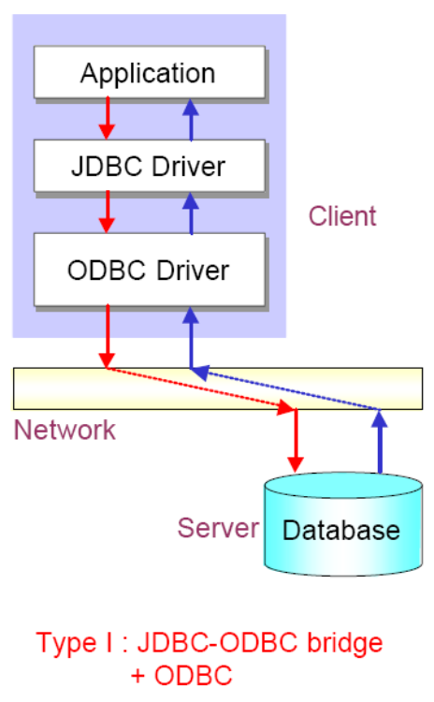
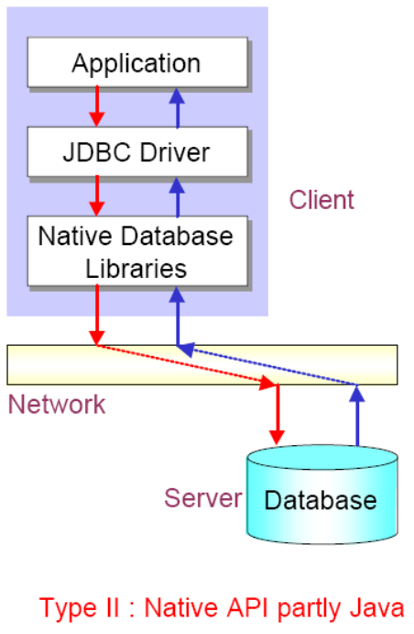
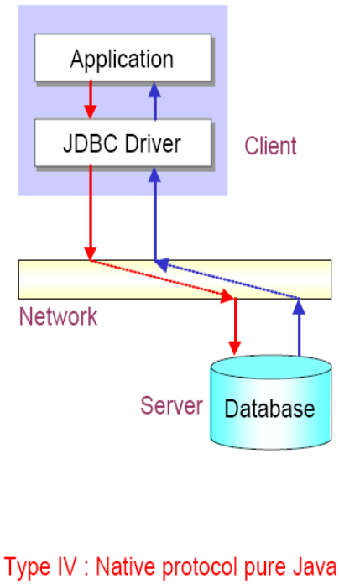
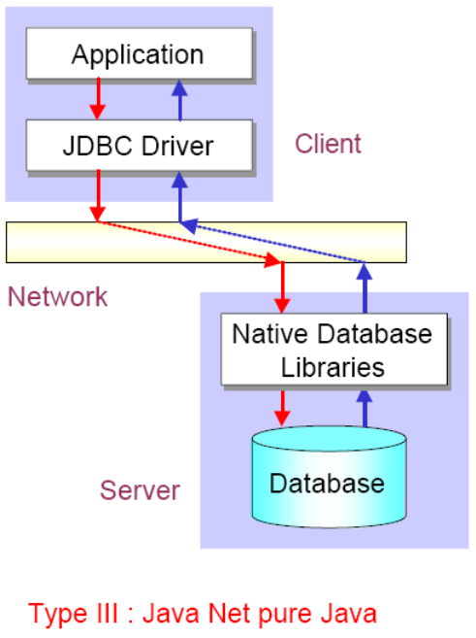
JDBC Driver Type
JDBC-ODBC bridge plus ODBC driver
Native-API partly-Java driver
JDBC-Net pure Java driver
Native Protocol pure Java API driver

Slide 31
JDBC Programming Steps
Connect
Register the driver
Create a connection to the database
Query
Create a statement
Query the database
Process Results
Get a result set
Assign results to Java variables
Close
Close the result set
Close the statement
Close the connection

Slide 32
Skeleton Code
Loading a JDBC driver
Class.forName(DRIVERNAME);
Connection con = DriverManager.getConnection(
CONNECTIONURL, DBID, DBPASSWORD);
Statement stmt = con.createStatement();
ResultSet rs = stmt.executeQuery(“SELECT a, b, c FROM member);
While(rs.next())
{
  Int x = rs.getInt(“a”);
  String s = rs.getString(“b”);
  Float f = rs.getFloat(“c”);
}
rs.close();
stmt.close();
con.close();
Connecting to a database
Executing SQL
Processing the result set
Closing the connections

Slide 33
Step 1 : Loading a JDBC Driver
A JDBC driver is needed to connect to a database
Loading a driver requires the class name of the driver.
Ex) JDBC-ODBC: sun.jdbc.odbc.JdbcOdbcDriver
Oracle driver: oracle.jdbc.driver.OracleDriver
MySQL: com.mysql.jdbc.Driver
Loaing the driver class
Class.forName("com.mysql.jdbc.Driver");
It is possible to load several drivers.
The class DriverManager manages the loaded driver(s)

Slide 34
Step 2 : Connecting to a Database (1/2)
JDBC URL for a database
  Identifies the database to be connected
  Consists of three-part:
  jdbc:<subprotocol>:<subname>
Protocol: JDBC is the only protocol in JDBC
Sub-protocol: identifies a database driver
Protocol: JDBC is the only protocol in JDBC
Sub-protocol: identifies a database driver
Subname: indicates the location and name of the database to be accessed. Syntax is driver specific
Subname: indicates the location and name of the database to be accessed. Syntax is driver specific
Ex) jdbc:mysql://oopsla.snu.ac.kr/mydb
The syntax for the name of the database is a little messy and is unfortunately vendor specific

Slide 35
Step 2 : Connecting to a Database (2/2)
The DriverManager allows you to connect to a database using the specified JDBC driver, database location, database name, username and password.
It returns a Connection object which can then be used to communicate with the database.
Connection connection = DriverManager.getConnection("jdbc:mysql://oopsla.snu.ac.kr/mydb",“userid",“password");
JDBC URL
Vendor of database, Location of database server and name of database
JDBC URL
Vendor of database, Location of database server and name of database
Password
Username
Password
Username

Slide 36
Step 3 : Executing SQL (1/2)
Statement object
  Can be obtained from a Connection object
  Sends SQL to the database to be executed
Statement has three methods to execute a SQL statement:
  executeQuery() for QUERY statements
    Returns a ResultSet which contains the query results
  executeUpdate() for INSERT, UPDATE, DELETE, or DDL statements
    Returns an integer, the number of affected rows from the SQL
  execute() for either type of statement
Statement statement = connection.createStatement();

Slide 37
Step 3 : Executing SQL (2/2)
Execute a select statement
Statement stmt = conn.createStatement();
ResultSet rset = stmt.executeQuery
("select RENTAL_ID, STATUS from ACME_RENTALS");
Execute a delete statement
Statement stmt = conn.createStatement();
int rowcount = stmt.executeUpdate
("delete from ACME_RENTAL_ITEMS
where rental_id = 1011");
Notes:
Dynamically Executing an Unknown SQL Statement
The following example uses execute() to dynamically execute an unknown statement:
public void executeStmt (String statement) throws SQLException {
Statement stmt = conn.createStatement();
// Execute the statement
boolean result = stmt.execute(statement);
if (result) { // statement was a query
ResultSet rset = stmt.getResultSet();
// Process the results
...
}
else { // statement was an update or DDL
int updateCount = stmt.getUpdateCount();
// Process the results
...
}
}

Slide 38
Step 4 : Processing the Results (1/2)
JDBC returns the results of a query in a ResultSet object
  ResultSet object contains all of the rows which satisfied the conditions in an SQL statement
A ResultSet object maintains a cursor pointing to its current row of data
  Use next() to step through the result set row by row
    next() returns TRUE if there are still remaining records
  getString(), getInt(), and getXXX() assign each value to a Java variable
Internal Pointer
ResultSet
Record 1
Record 2
Record 3
Record 4
The internal pointer starts one before the first record

Slide 39
Step 4 : Processing the Results (2/2)
Example
  Statement stmt = con.createStatement();
  ResultSet rs = stmt.executeQuery(“SELECT ID, name, score FROM table1”);
  While (rs.next()){
    int id = rs.getInt(“ID”);
    String name = rs.getString(“name”);
    float score = rs.getFloat(“score”);
    System.out.println(“ID=” + id + “ ” + name + “ ” + score);}
NOTE
You must step the cursor to the first record before read the results
This code will not skip the first record
ID | name | score
1 | James | 90.5
2 | Smith | 45.7
3 | Donald | 80.2
Output
ID=1 James 90.5
ID=2 Smith 45.7
ID=3 Donald 80.2
Table1

Slide 40
Step 5 : Closing Database Connection
It is a good idea to close the Statement and Connection objects when you have finished with them
Close the ResultSet object
rs.close();
Close the Statement object
stmt.close();
Close the connection
  connection.close();

